Slide 1
Introduction to Redfish
DMTF Scalable Platforms Management Forum
May 2016

Slide 2
Disclaimer
The information in this presentation represents a snapshot of work in progress within the DMTF.
This information is subject to change without notice. The standard specifications remain the normative reference for all information.
For additional information, see the Distributed Management Task Force (DMTF) website.

Slide 3

What is Redfish?
Industry Standard RESTful API for IT Infrastructure
  HTTPS in JSON format based on Odata v4
  Equally usable by Apps, GUIs and Scripts
  Schema-backed but human-readable
Version 1 focused on Servers
  A secure, multi-node capable replacement for IPMI-over-LAN
  Add devices over time to cover customer use cases & technology
    PCIe Switching, Local Storage, NVDIMMs, Multifunction Adapters, Composability
  Intended to meet OCP Remote Machine Management requirements
Expand scope over time to rest of IT infrastructure
  Working with SNIA to cover more advanced storage.
  Plan on working with partners like the Green Grid to cover Power/Cooling
  Goal is to accommodate or map existing switch standards over time.

Slide 4










Scalable Platforms Management Forum
(DMTF Group that Defines Redfish)
Co-Chairs: Jeff Autor (HPE), Paul Vancil (Dell)
Leadership Companies
Supporting Companies
AMI, Cisco, Fujitsu, Western Digital, Huawei, IBM, Insyde Software, Mellanox, NetApp, Oracle, Microsemi, Qualcomm, Seagate
Industry Alliance Partners
OpenCompute Project
UEFI - Collaborating on Firmware Update and Host Interface work
SNIA – Collaborating on Storage modeling / alignment between SSM and Redfish
TGG – Pursuing relationship to work on Power/Cooling (existing DMTF Alliance Partner)
May 17, 2016
4
Notes:
4

Slide 5
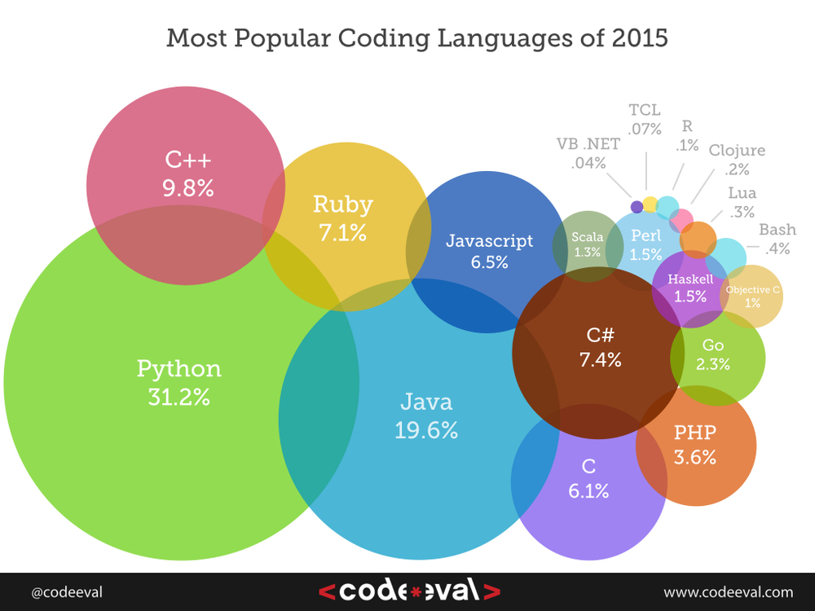
Why REST, HTTP and JSON?
REST: The API architecture
  Rapidly replacing SOAP
HTTPS: The Web protocol
  Well-understood by admins
  Known security model
  Known network configuration
JSON: Modern data format
  Human-readable
  Simpler than XML
  Modern language support
The combination of language support and ubiquity of REST, HTTP and JSON means that systems management tasks can be performed using the same skill set and tool chain as all other IT and dev/ops tasks.

Slide 6
How simple is REST using JSON?
Example Python code to retrieve serial number from a server:
rawData = urllib.urlopen(‘http://192.168.1.135/redfish/v1/Systems/1’)
jsonData = json.loads(rawData)
print( jsonData[‘SerialNumber’] )
Output is:
*Example uses Redfish ComputerSystem resource,
Authentication not shown
1A87CA442K

Slide 7
Redfish v1.0 Feature Set
Retrieve “IPMI class” data
Basic server identification and asset info
Health state
Temperature sensors and fans
Power supply, power consumption and thresholds
  Basic I/O infrastructure data
  Host NIC MAC address(es) for LOM devices
  Simple hard drive status / fault reporting
  Perform Common Actions
Reboot / power cycle server
Change boot order / device
Set power thresholds
  Access and Notification
Serial console access via SSH
Alert / event notification method(s)
Event Log access method(s)
  Discovery
  Service endpoint (network-based discovery)
  System topology (rack/chassis/server/node)
BMC infrastructure
View / configure BMC network settings
Manage local BMC user accounts
  Security
  Session-based leverages HTTPS
Working on more…

Slide 8
Redfish releases
v1.0 Released August 2015
  Specification and Schema files
v1.1 Release November 2015
  Spec 1.0.1, Schema 1.1, 1.0.1 and 1.0
2016.1 Release April, 2016
  Spec 1.0.2, Schema 1.2, 1.1, 1.0.2 and 1.0
Releases planned for Schema and Specification
  2016.2 - Summer 2016 (August)
  2016.3 - Fall 2016 (December)
Expecting 3 releases per year.
  Each release will have updates, errata and additions that are ready at that time
Download specification, white paper, FAQ, schemas, Works in Progress:
  http://www.dmtf.org/standards/redfish

Slide 9

Redfish 2016 Release 1
Redfish Specification v1.0.2 (errata)
NEW Schemas v1.0.0
  AttributeRegistry, Bios, Drive, Memory, MemoryCollection, MemoryMetrics, SecureBoot, Storage, StorageCollection, Volume
Schemas v1.1.0 or v1.2.0 (minor revs)
  Chassis, ComputerSystem, Event, Manager, Power, Resource, SimpleStorage, Thermal
Schemas v1.x.2 (errata)
Schema Release Bundles (posted at http://www.dmtf.org/standards/redfish)
  DSP8010_2016.1: All new, minor, and errata 2016.1 schemas
    Individual file contents also posted on http://redfish.dmtf.org/schemas
  DSP8010_2016.0.9a: Work in Progress
  New schemas under development within SPMF

Slide 10

Expected Redfish Open Source Efforts
Conformance Tool
Client Library
Common utility support functions
  Discovery, Enumeration, etc.
  Event subscription
Typical tasks
  Power on/off/reboot
  Gather thermal data
Languages under consideration
  Python
  Java
  PowerShell
  Other possibilities…
Command Line Utility
Similar to IPMItool
Designed for end users
Calls Client library
Likely written in Python
Conformance Test Suite
Schema validation (JSON and CSDL)
Payload validation
Spec and Schema conformance
Checklist for vendors and customers
Avoid spec interpretation conflicts

Slide 11
Introduction to the Redfish data model
All resources linked from a Service Entry point (root)
  Always located at URL: /redfish/v1
Major resource types structured in ‘collections’ to allow for standalone, multi-node, or aggregated rack-level systems
  Additional related resources fan out from members within these collections
ComputerSystem: properties expected from an OS console
  Items needed to run the “computer”
  Roughly a logical view of a computer system as seen from the OS
Chassis: properties needed to locate the unit with your hands
  Items needed to identify, install or service the “computer”
  Roughly a physical view of a computer system as seen by a human
Managers: properties needed to perform administrative functions
  aka: the systems management subsystem (BMC)

Slide 12
Resource map (highlights)
/redfish/v1
/redfish/v1/Systems
Root Resource
Collection of Systems
/redfish/v1/Systems/<id>
Links to all content
“Logical” view of the system
1..n
Server Information
Model #, Serial #, Boot Order, NIC MAC, status, etc.
Sessions
Accounts
/redfish/v1/Chassis
Processors
Schemas
Collection of Chassis
Disks
“Physical” view of the system
NICs
Events
/redfish/v1/Chassis/<id>
/redfish/v1/Managers
1..n
Chassis
Collection of Managers
Chassis global physical asset info
BMC functionality
Power
Thermal
/redfish/v1/Managers/<id>
1..n
BMC
System Manager operations
Services
Logs

Slide 13
More on Redfish:
Join the SPMF
  Help shape the standard
  http://www.dmtf.org/join/spmf
We want your Feedback
  On the Standard or Works in Progress
  http://www.dmtf.org/standards/feedback
Redfish Standards
  Schemas, Specs, Mockups, White Papers, FAQ, Educational Material & more
  http://www.dmtf.org/standards/redfish
Redfish Developer Portal
  Redfish Interactive Explorer, Hosted Schema at Namespace & other links
  http://redfish.dmtf.org
SPMF (WG that defines Redfish)
  Companies involved, Upcoming Schedules & Future work, Charter, Information on joining.
  http://www.dmtf.org/standards/spmf

